Slide 1

Smart Plant Monitoring
By Team Exemplary
Asm Nurussafa
Tasawar Siddiquy Arfat Kamal
Nirojan Navaratnarajah
For the module Advanced Embedded System.

Slide 2
Agenda
Motivation. (Arfat)
Concept description . (Arfat)
Technologies used. (Tasawar)
Applications and use cases. (Nurussafa)
Implementation description. (Neero)
Video demonstration. (Neero)
Results. (Neero)
Summary.

Slide 3
Motivation

Slide 4
2. Concept Description

Slide 5
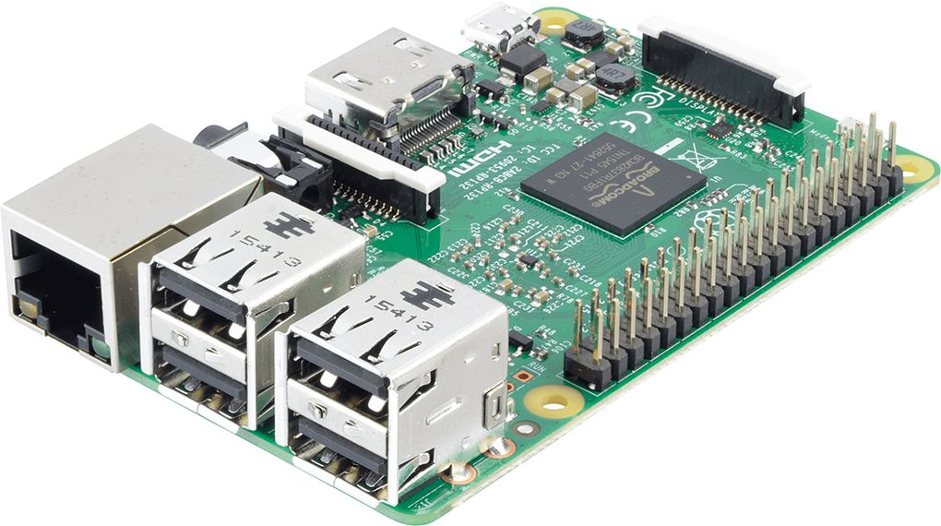
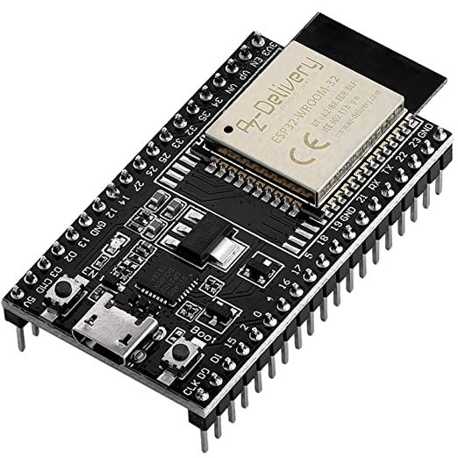
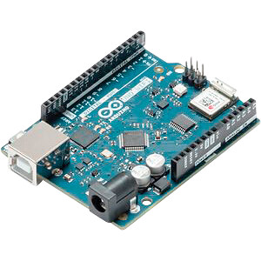
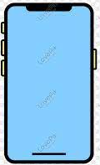
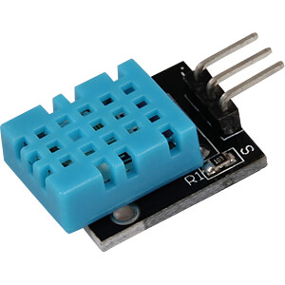
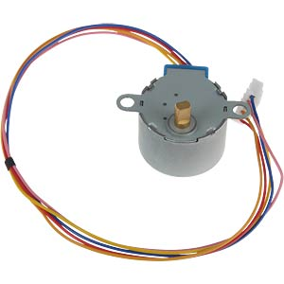
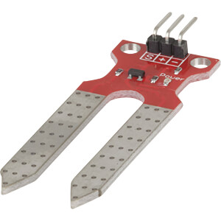
Hardware components used in the project.
Broker
Client 01
[1]
Client 02
Client 03
[5]
[4]
[2]
[7]
[6]
[3]

Slide 6
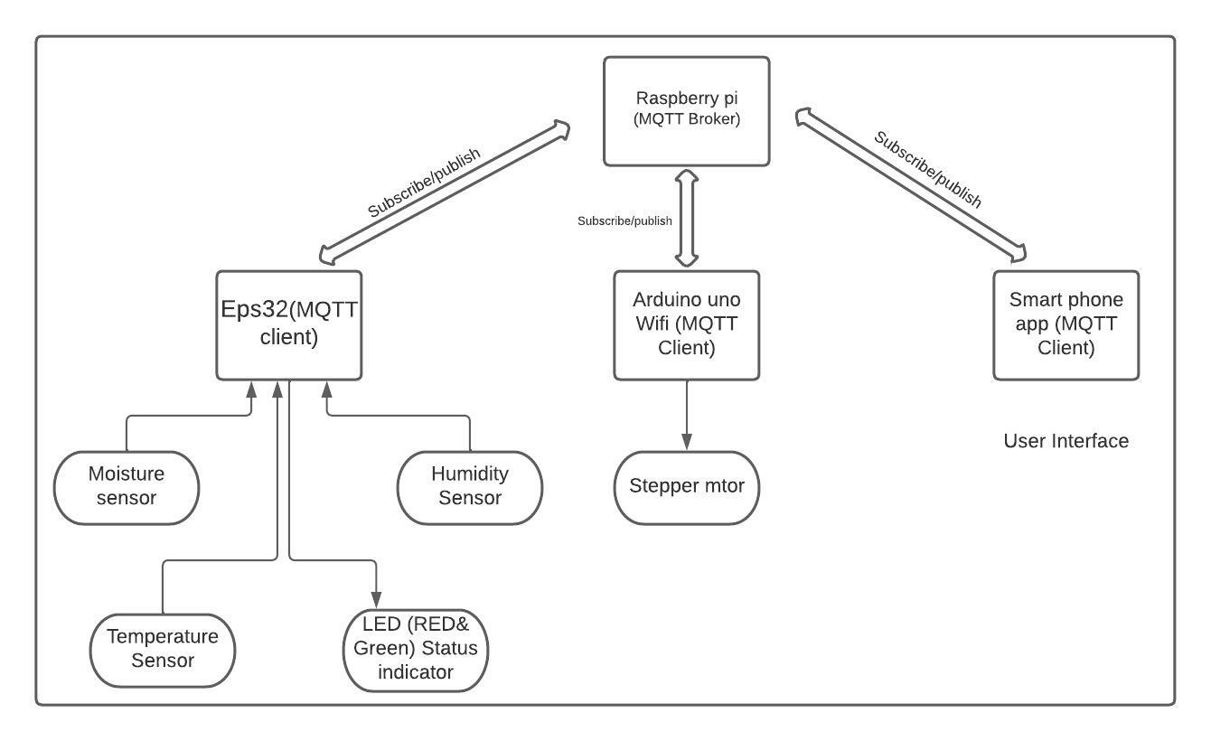
Block diagram

Slide 7
3. Technologies

Slide 8
Temperature and Humidity Sensor (DHT11) & Soil Moisture Sensor (ME110)

Slide 9
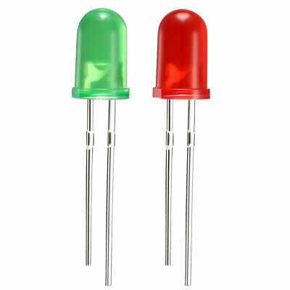
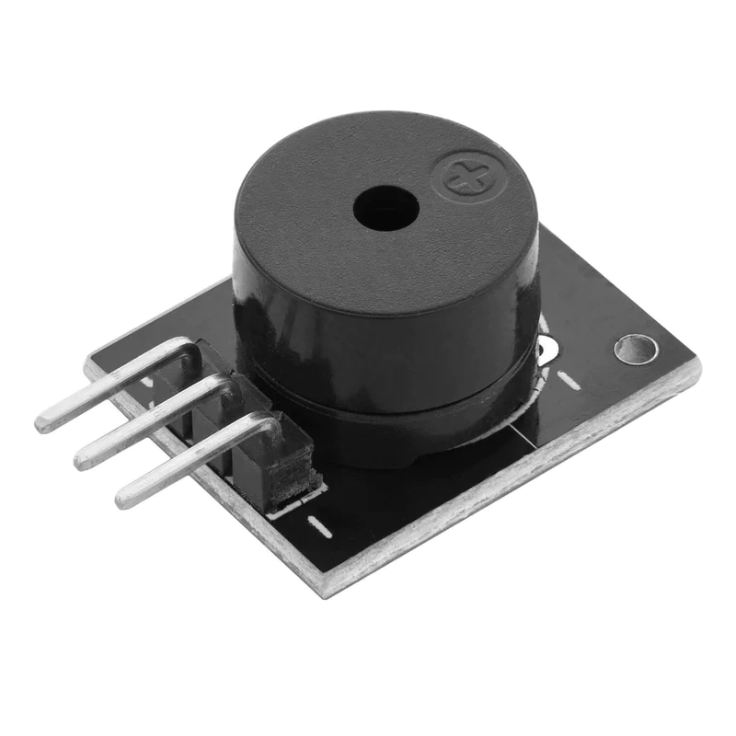
LED , Buzzer & Stepper motor

Slide 10
MQTT - Message Queuing Telemetry Transport
MQTT is a bi-directional communication protocol where each client can both produce and consume data by publishing messages and subscribing to topics

Slide 11
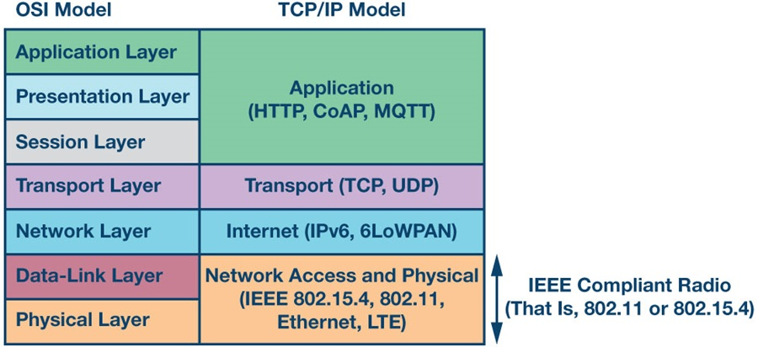
MQTT protocol is an Application layer protocol.
[8]

Slide 12
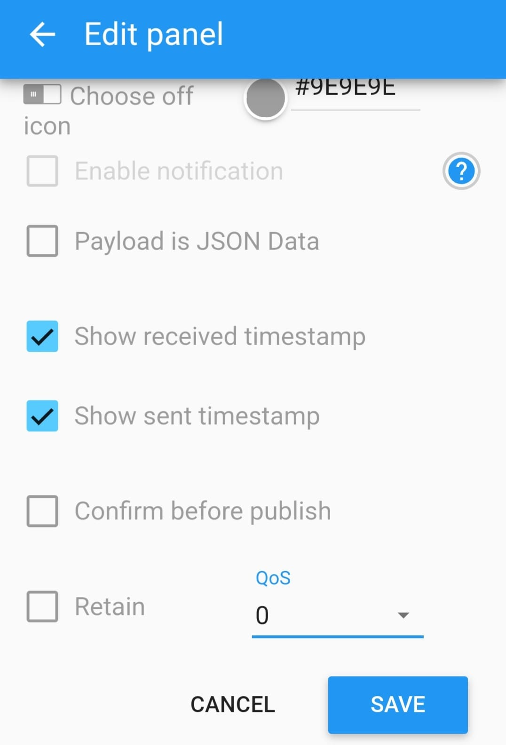
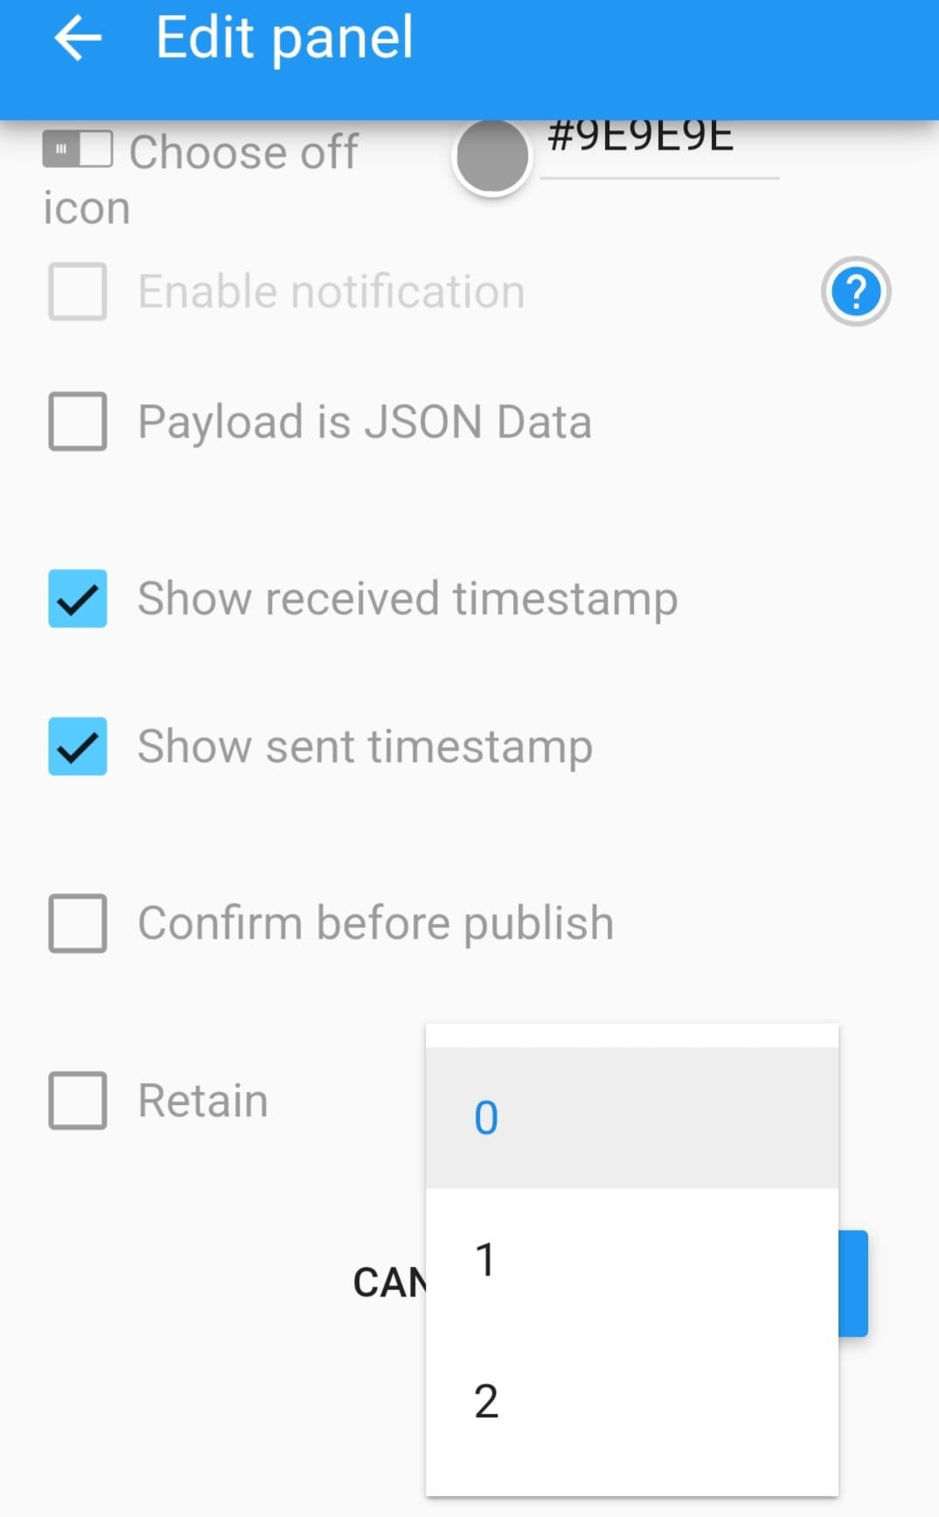
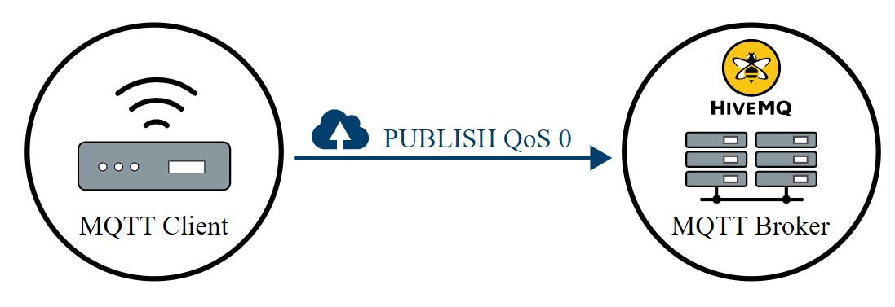
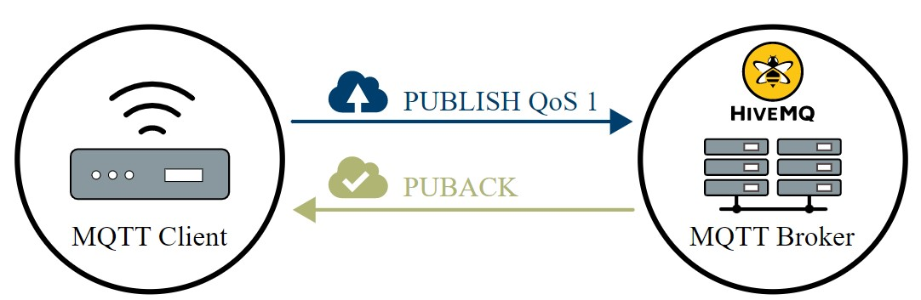
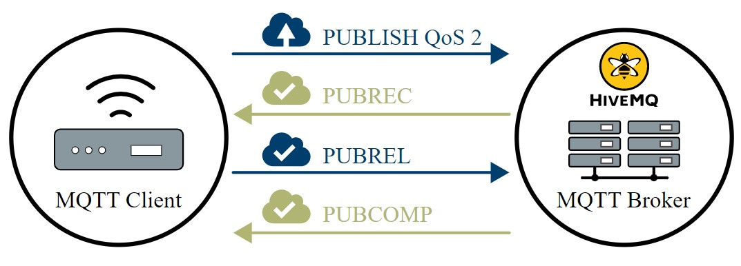
QOS Levels
There are 3 QoS levels in MQTT: (Quality of Service)
At most once (0)
At least once (1)
Exactly once (2).
[2]

Slide 13
4. Application and use cases

Slide 14
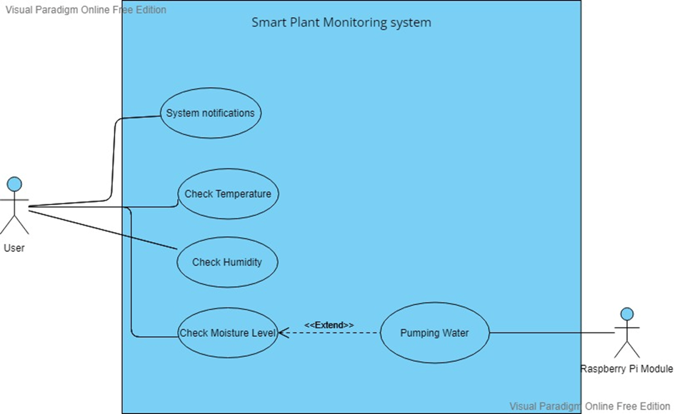
Use cases:

Slide 15
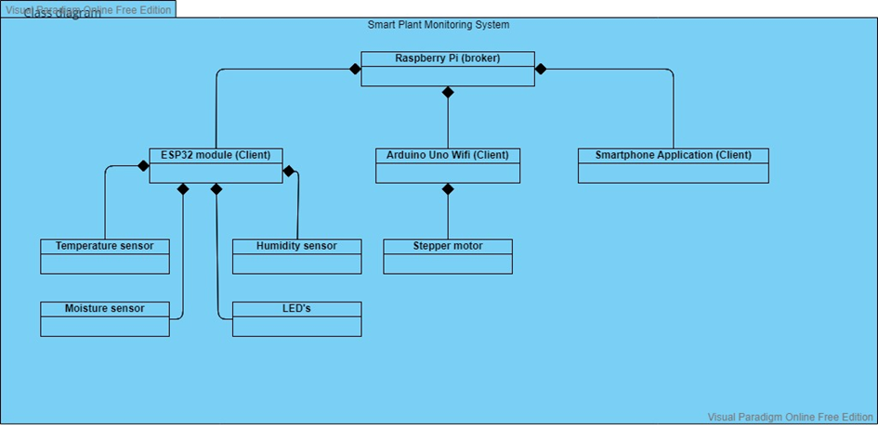
Class diagram:

Slide 16
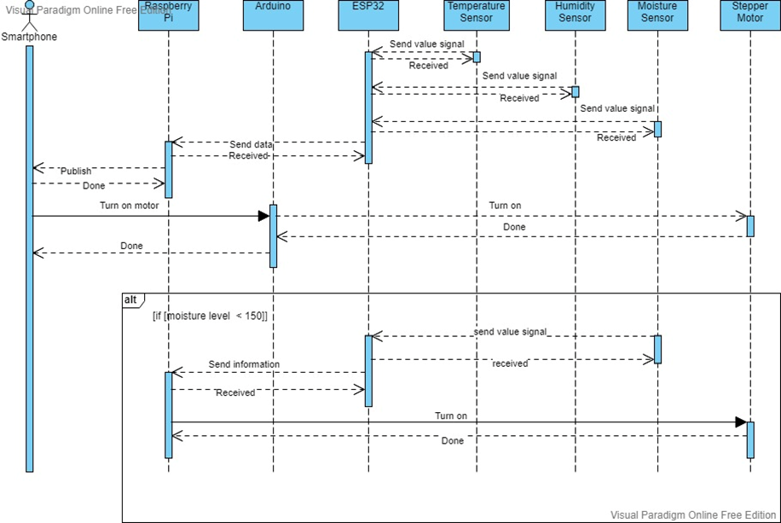
Sequence diagram:

Slide 17
Implementation description

Slide 18
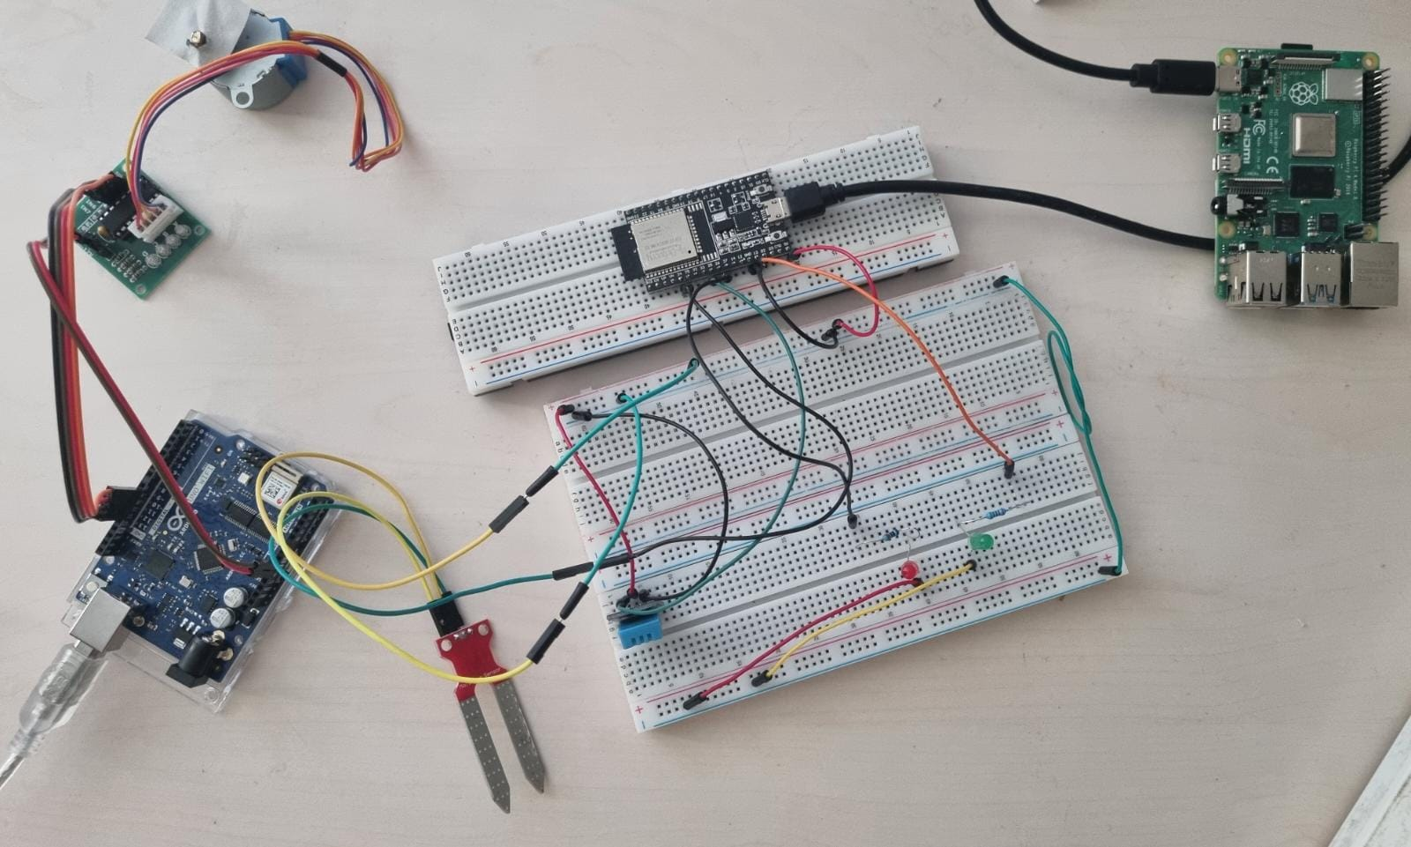
Static structure

Slide 19
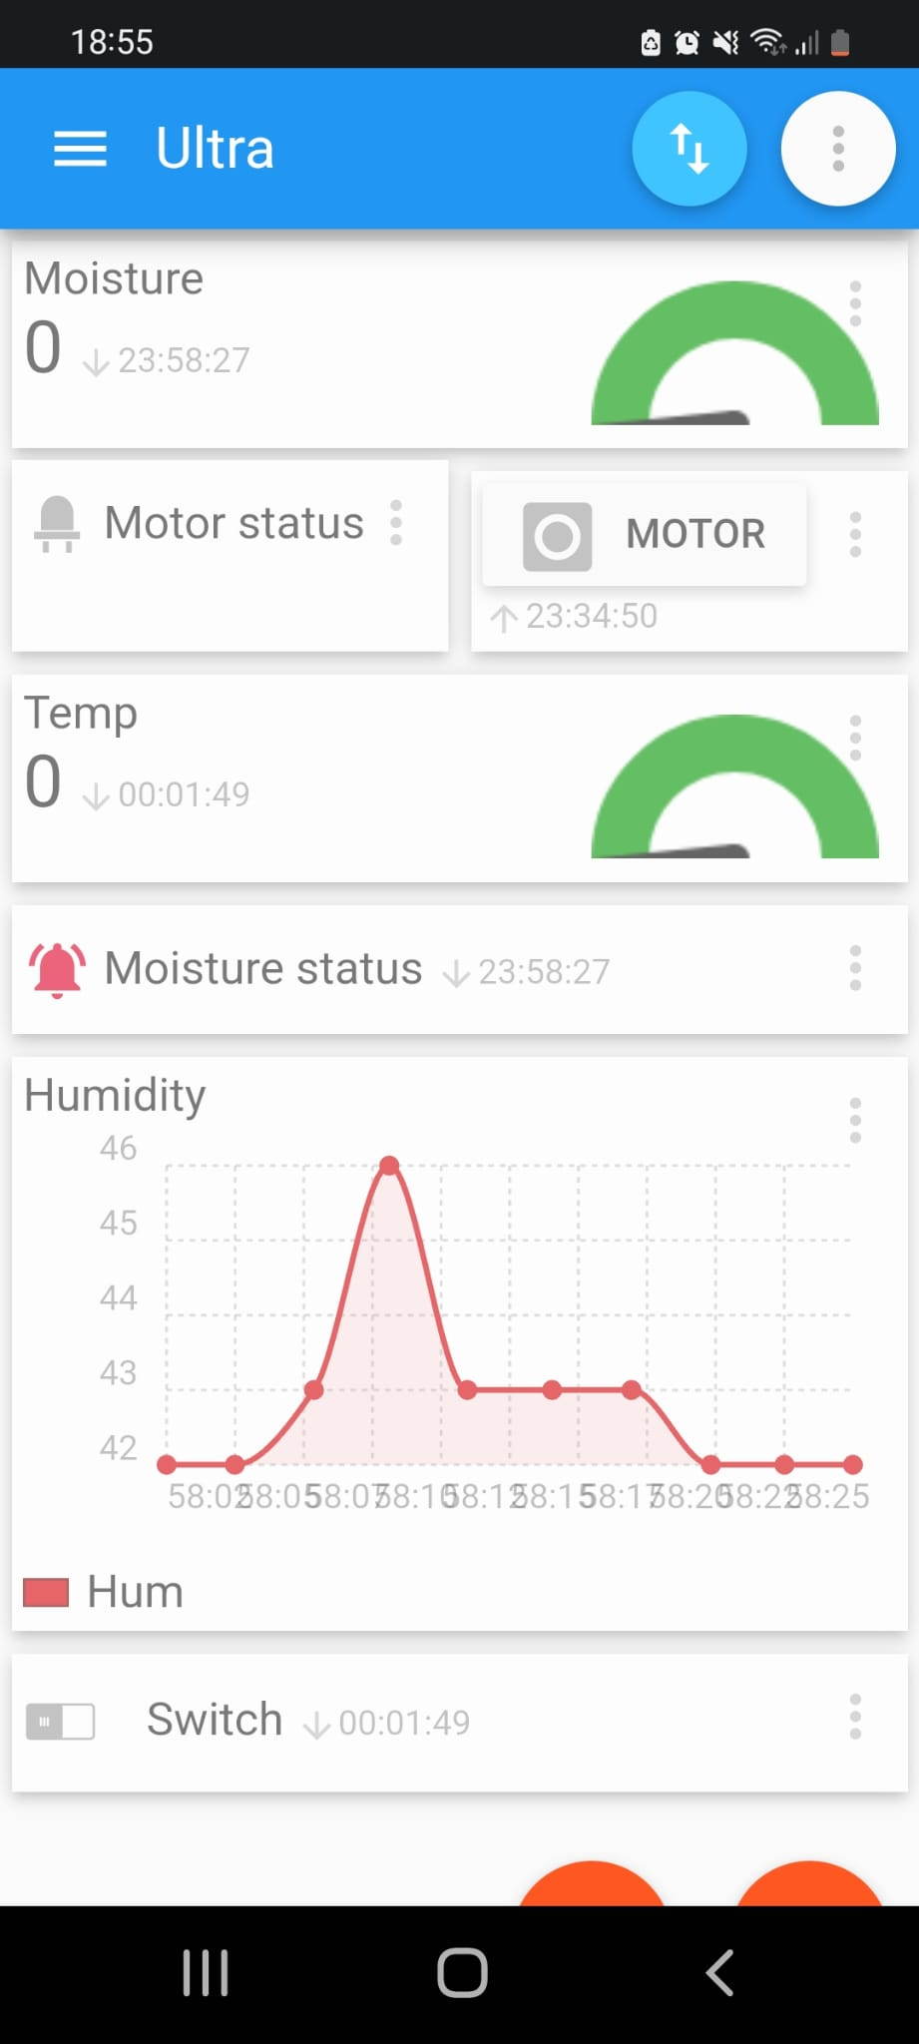
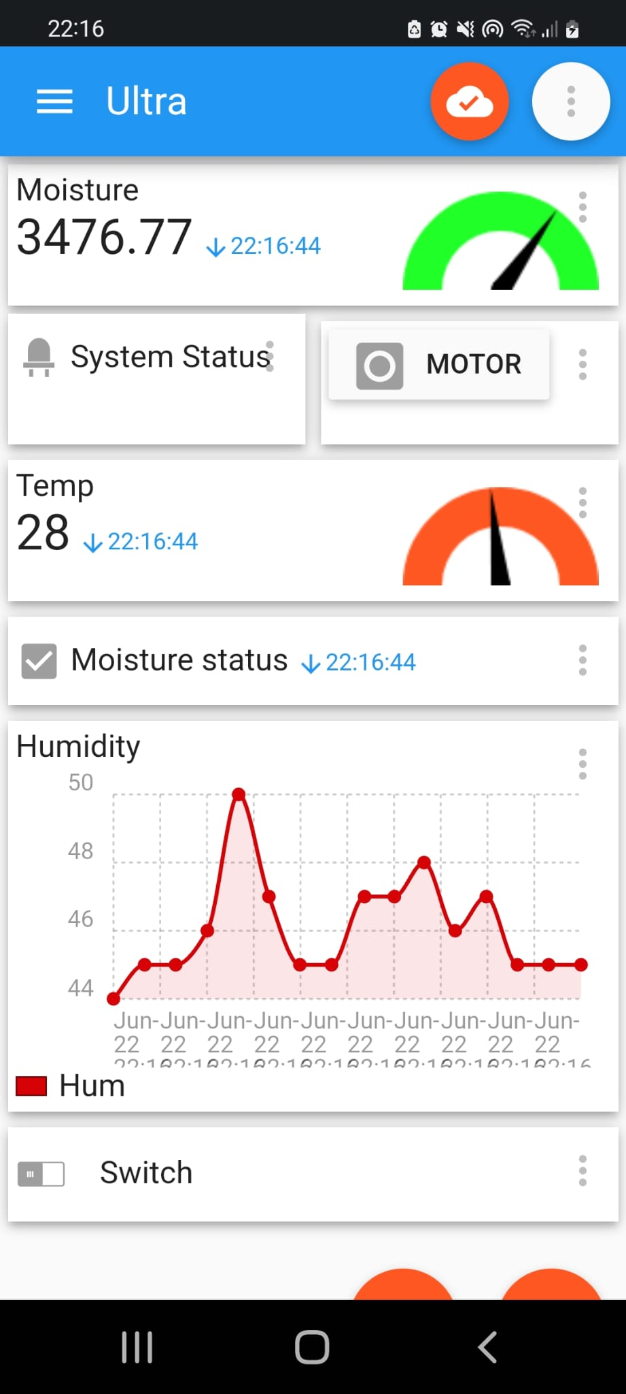
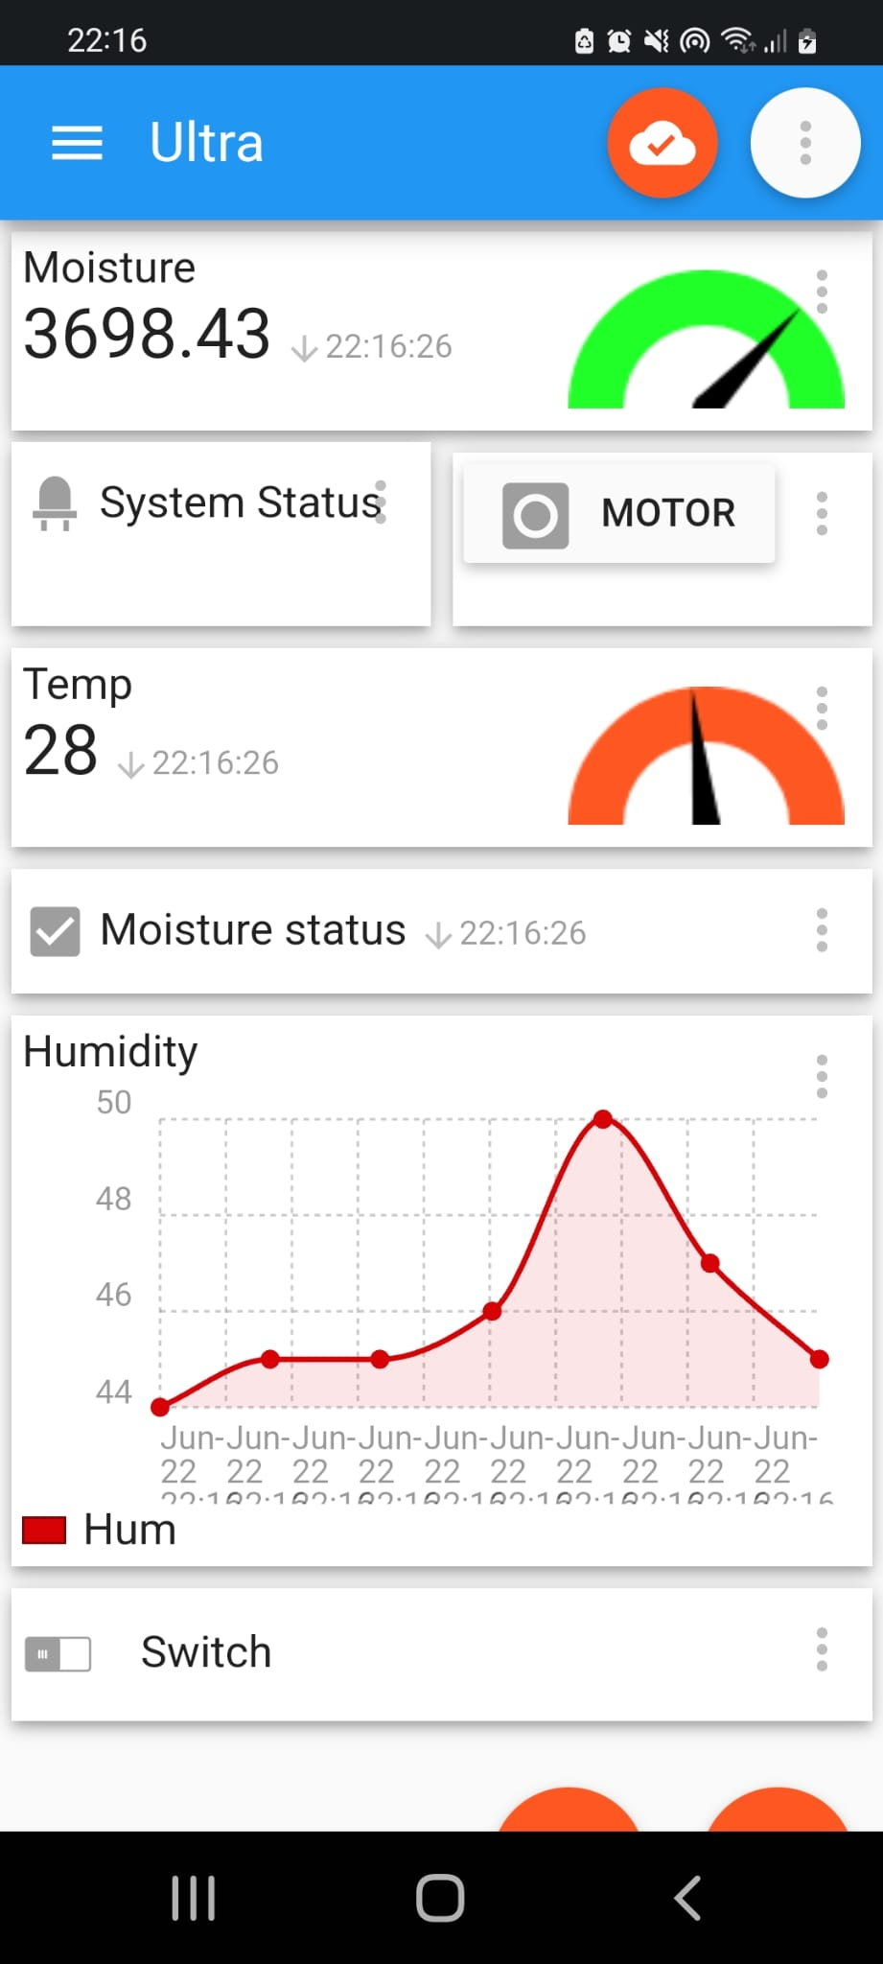
User Interface

Slide 20
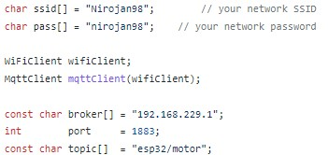
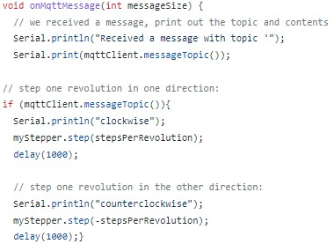
Arduino code

Slide 21

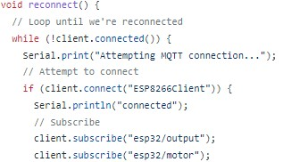
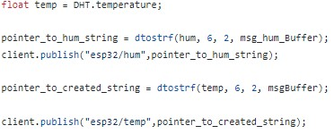
Esp32 code

Slide 22

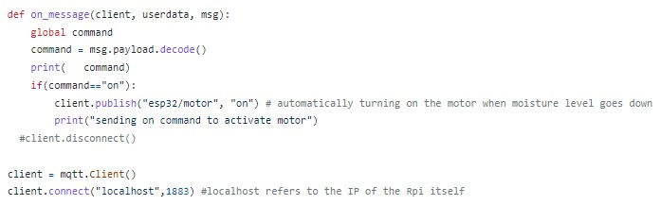
Automating the whole process of watering the plant
A simple python script is implemented to monitor the changes in the moisture level of the soil.

Slide 23
Video Demonstration

Slide 24
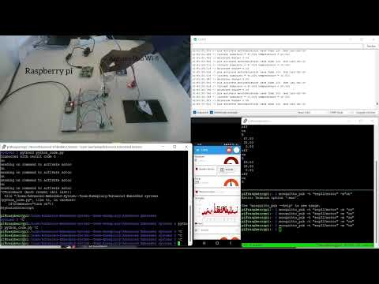

Slide 25
References
Github repository- https://github.com/Asm-Nurussafa/Advanced-Embedded-System--Team-Exemplary
[1] https://www.distrelec.de/de/raspberry-pi-modell-gb-ram-raspberry-pi-raspberry-pi-model/p/30085264
[2]https://www.reichelt.de/entwicklerboards-temp-feuchte-dht-11-debo-bo-dht-11-p239086.html?PROVID=2788&gclid=CjwKCAjwtcCVBhA0EiwAT1fY7y57Nj8I8es0CEmqigvr6Wq0yGRKT4GLmyhwdNRq4uctxCmUWw0o7hoCi3sQAvD_BwE
[3]https://www.reichelt.de/arduino-feuchtesensor-fuer-bodenfeuchte-ard-sen-wet1-p282511.html?PROVID=2788&gclid=CjwKCAjwtcCVBhA0EiwAT1fY79TXnUVht3-BB0SvqBkxO_Metz4OtC305AhsqlU8XDhH7D93AqykkhoCj_0QAvD_BwE
[4] https://www.amazon.de/ESP-32-Dev-Kit-V4-Parent/dp/B07Z83MF5W?th=1
[5]https://www.reichelt.de/arduino-uno-wifi-rev2-atmega-4809-arduino-uno-rev2-p248661.html?PROVID=2788&gclid=CjwKCAjwtcCVBhA0EiwAT1fY72fjJJK2zmu35t0cO3TaVqIX53rqmufEVOivmeAEYSIqXZ9DDc4wwRoCFugQAvD_BwE
[6]https://www.reichelt.de/entwicklerboards-schrittmotor-inkl-steuerung-uln2003-debo-moto1-p192146.html?PROVID=2788&gclid=CjwKCAjwtcCVBhA0EiwAT1fY72AfZkL5vcBqoo4m-7V_FgP7vVCvEDnr6O2wXquNZuJG9z2Nv_P_wBoC5iMQAvD_BwE
[7] https://lovepik.com/image-610825885/life-series-hand-drawn-cartoon-mobile-phone-iphone.html
[8] https://www.analog.com/ru/technical-articles/intelligence-at-the-edge-part-3-edge-node-communication.html

